Slide 1
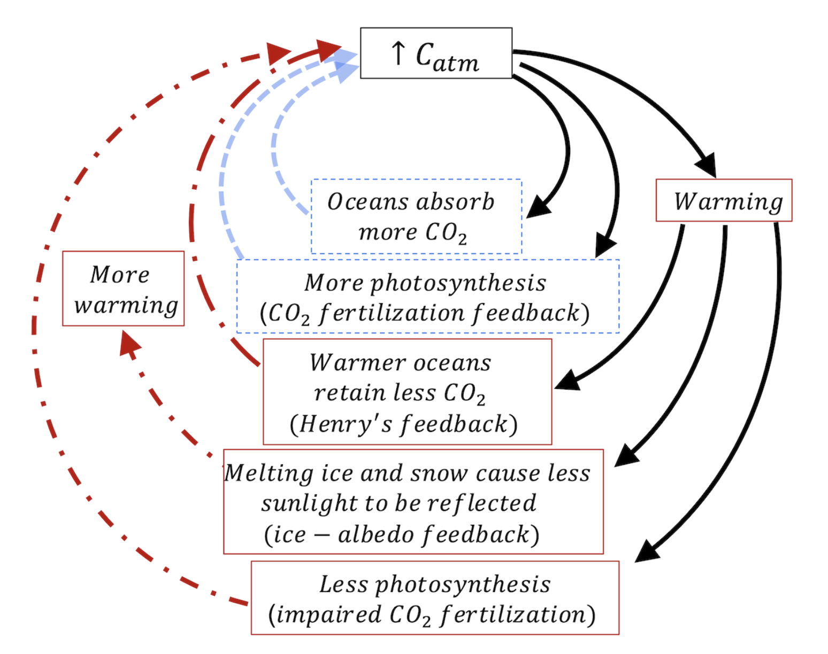
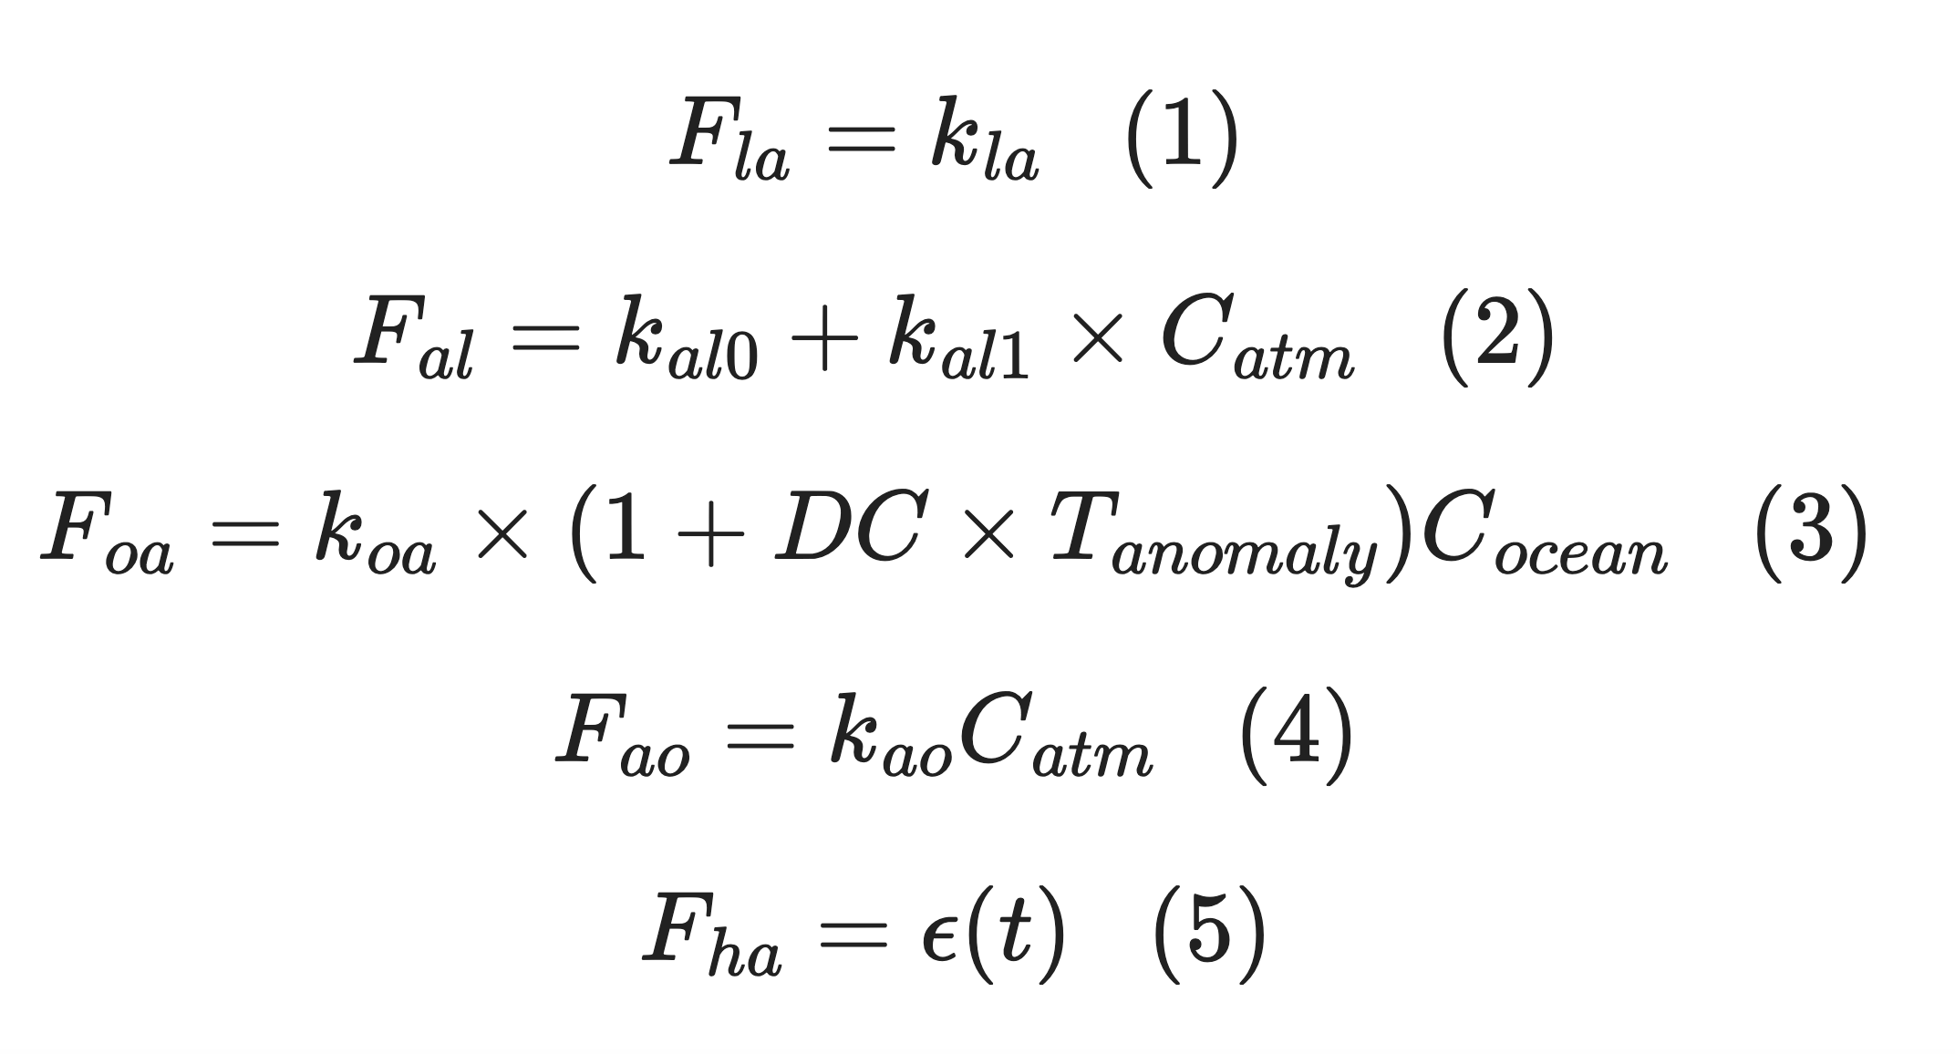
Recap: How Cambio 3.0 accounts for ice-albedo feedback

Slide 2
Recap: How Cambio 3.0 accounts for ice-albedo feedback
1
This is done inside the Cambio3 propagator
2
3

Slide 3
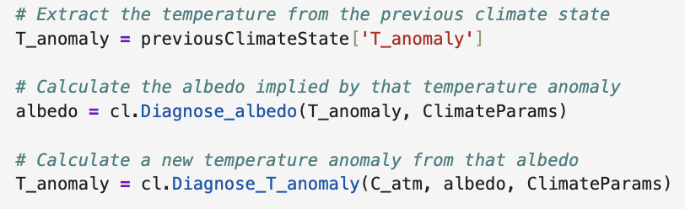
Recap: How Cambio 3.0 accounts for ice-albedo feedback
1
2
3
…
1
2
3

Slide 4
Two more Python notebooks to fetch this week -- today we’ll focus on ProjectTemplate

Slide 5
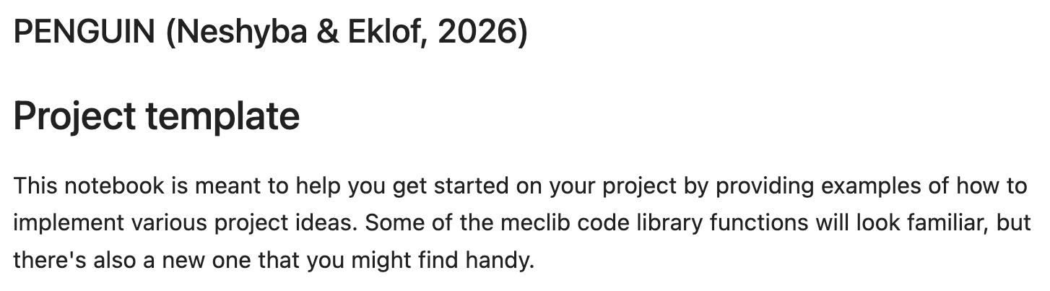
Your project template

Slide 6
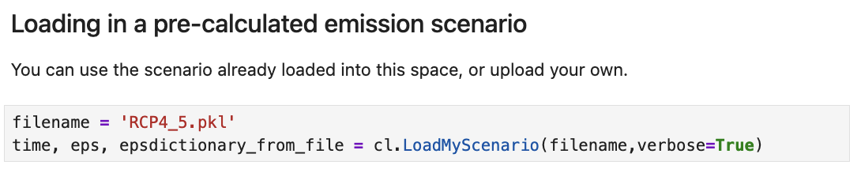
You already know about cl.LoadMyScenario
Of course, you can upload your own pickle file to use instead of RCP4_5.pkl

Slide 7
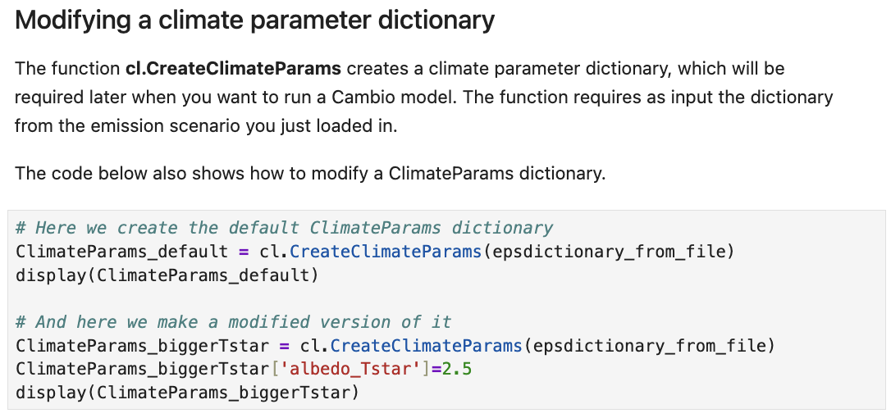
Using cl.CreateClimateParams to create a ClimateParams dictionary

Slide 8
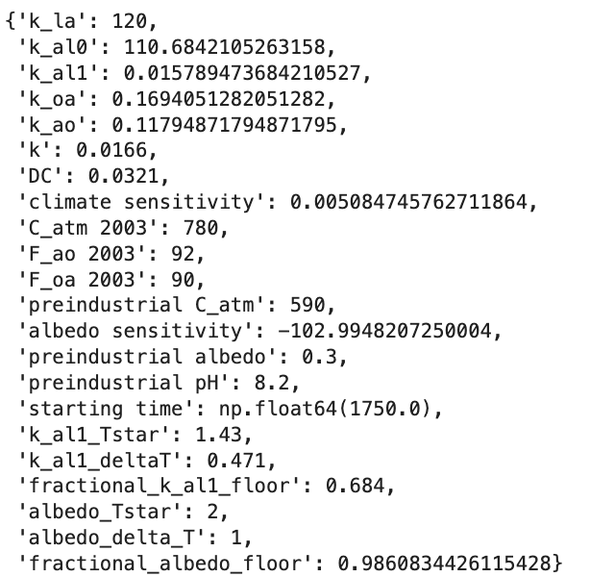
Using cl.CreateClimateParams to create a ClimateParams dictionary

Slide 9
Modifying a ClimateParams dictionary after it’s been created

Slide 10
Modifying a ClimateParams dictionary after it’s been created

Slide 11
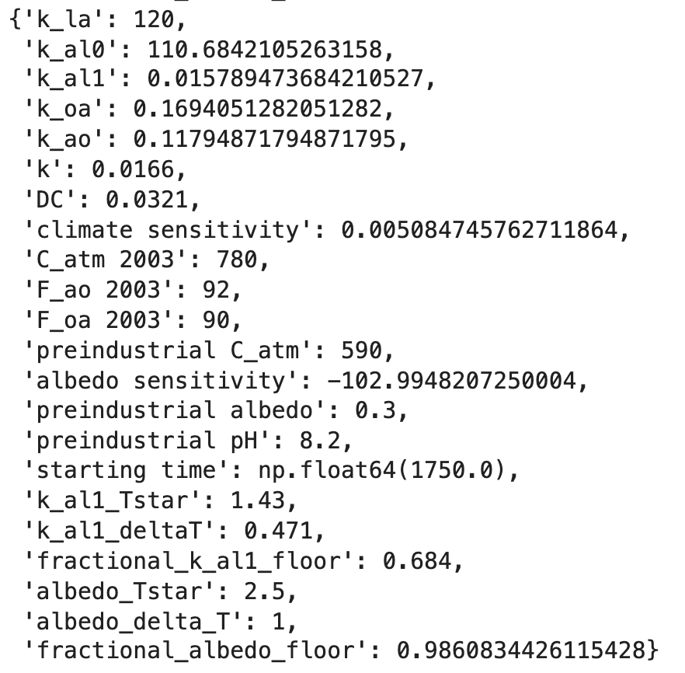
Modifying a ClimateParams dictionary after it’s been created

Slide 12
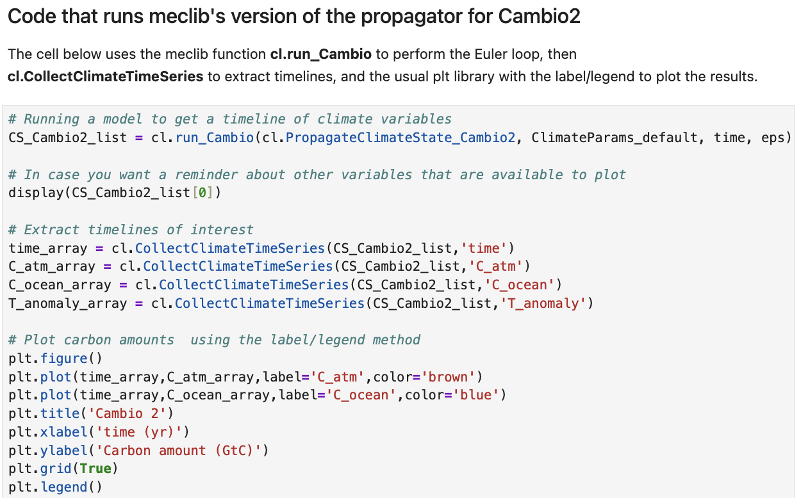
Using cl.run_Cambio and cl.CollectClimateTimeSeries

Slide 13
Also using the label/legend method for plotting

Slide 14
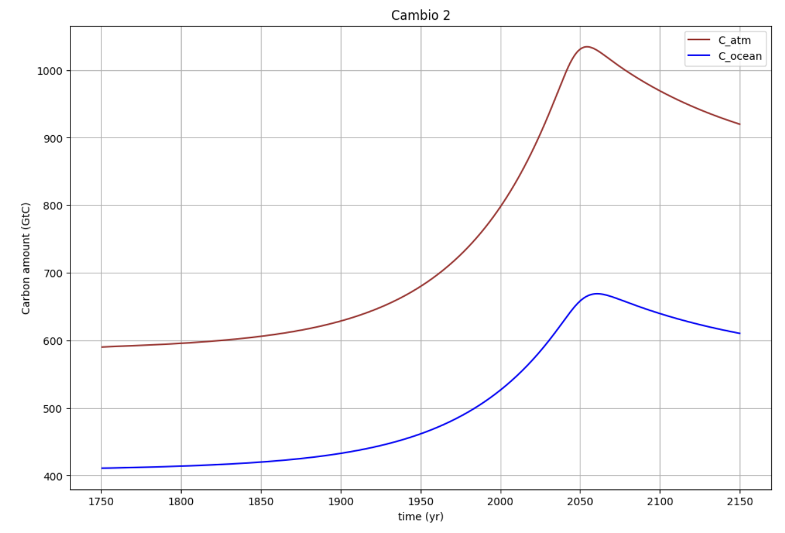
Also using the label/legend method for plotting

Slide 15
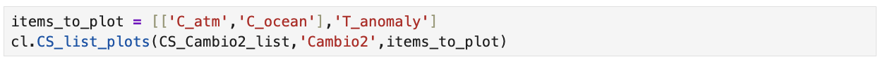
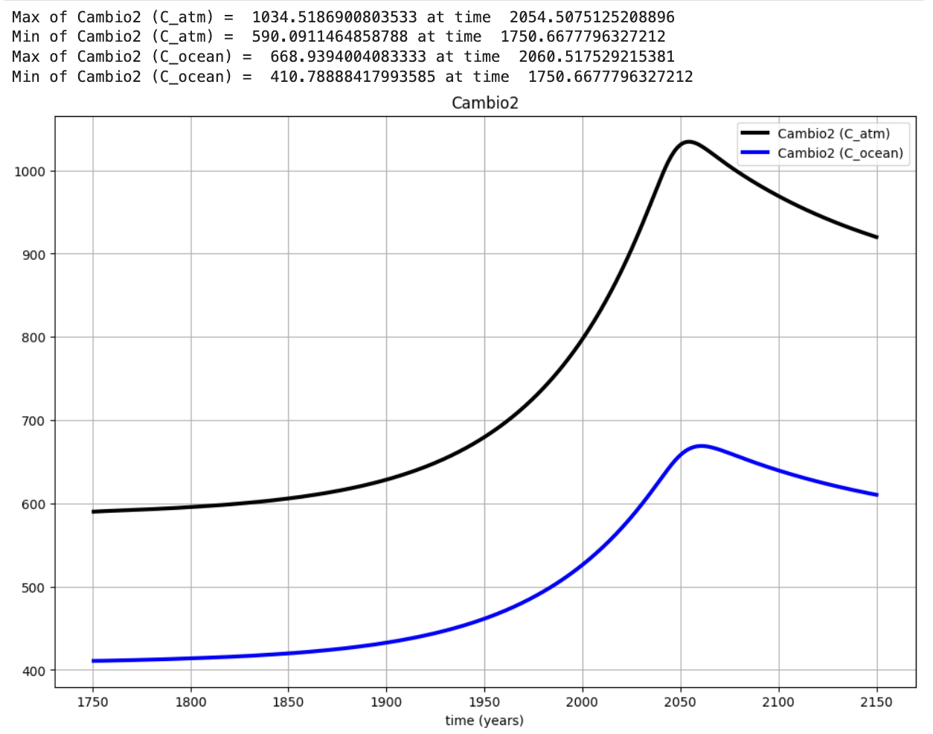
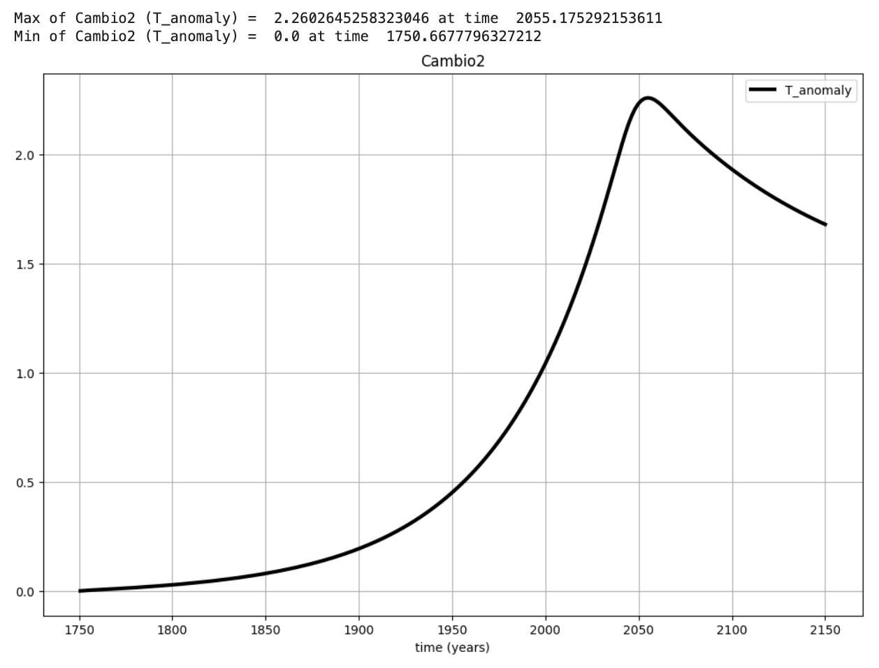
A plotting alternative: meclib’s cl.CS_list_plots

Slide 16
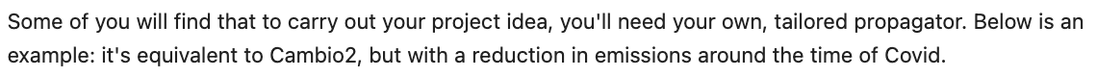
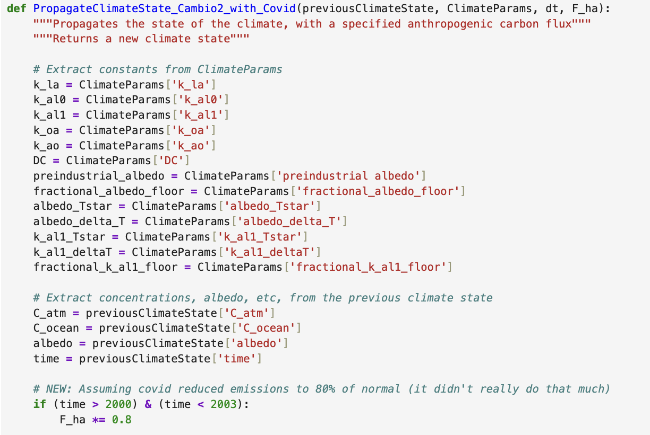
Tailoring your propagator

Slide 17
Tailoring your propagator

Slide 18
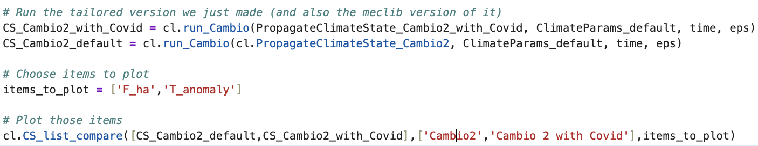
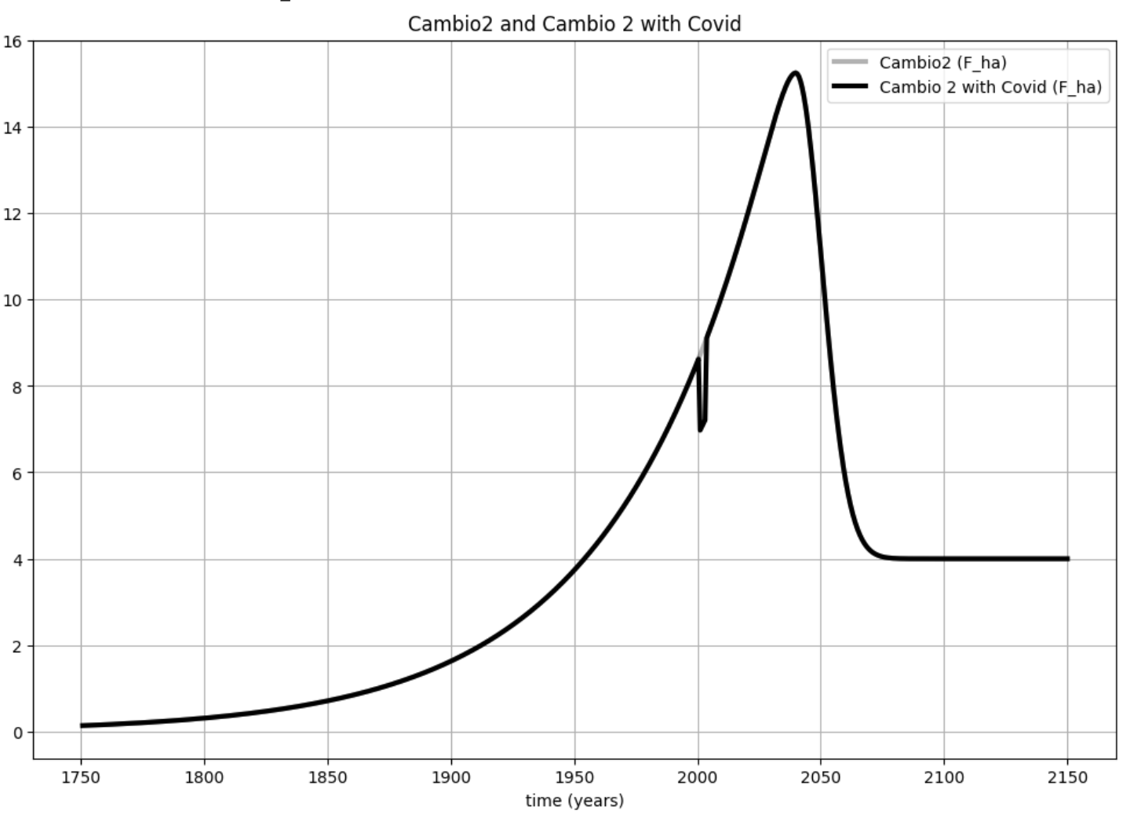
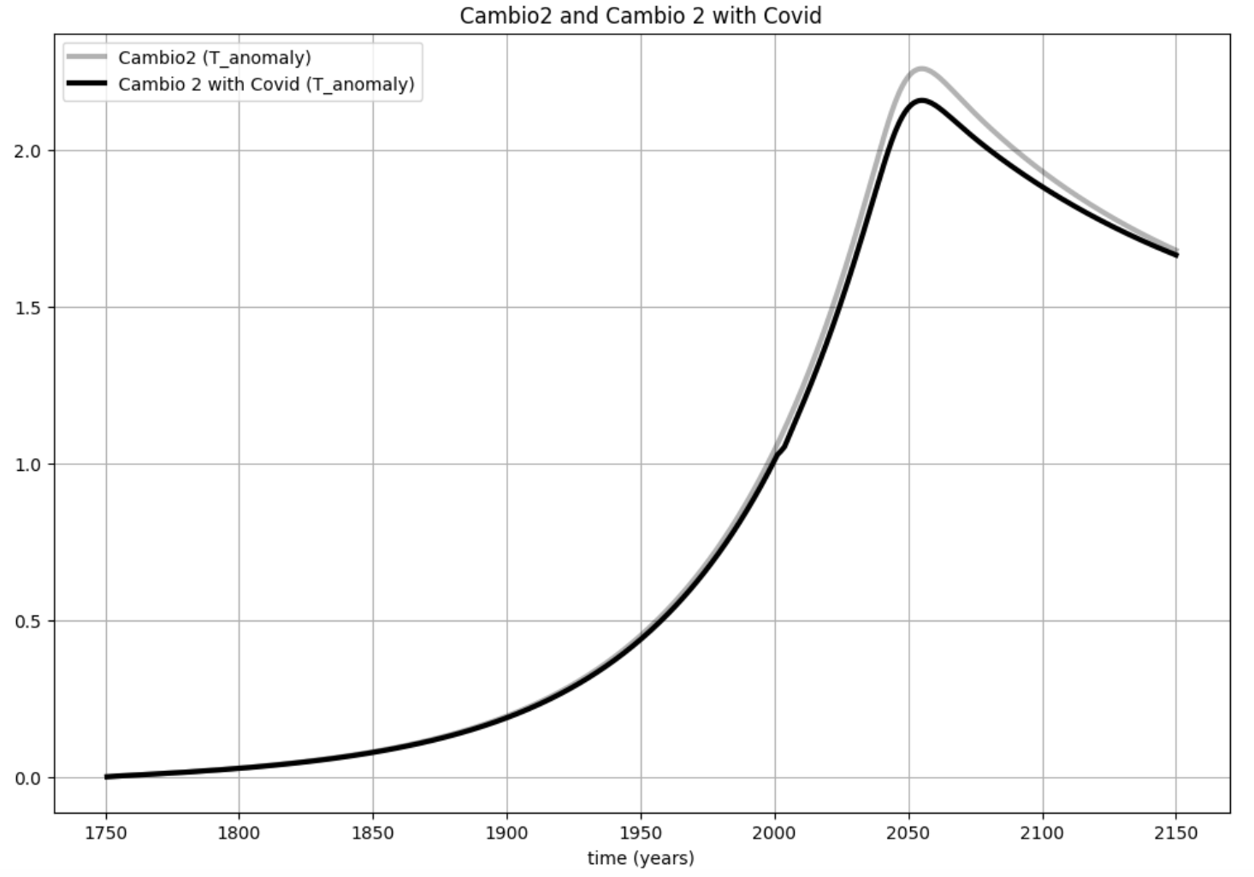
Running and plotting the results of your tailored propagator

Slide 19
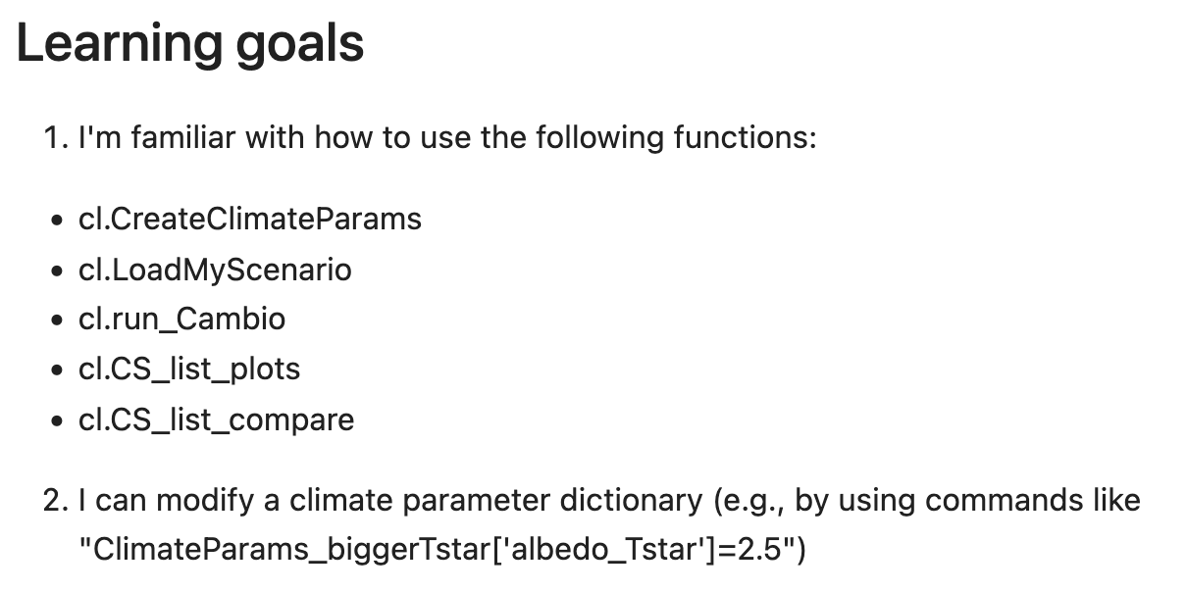
OK, let’s get started

